Slide 1


Signals & Systems for Computer Engineering
Prof.Dr. B.Berk ÜSTÜNDAĞ
Istanbul Technical University
Faculty of Computer Engineering and Informatics
BLG354E / CRN: 21615
6th Week Lecture (cont.)
2020
bustundag@itu.edu.tr
BLG354E / CRN: 21560
2nd Week Lecture

Slide 2

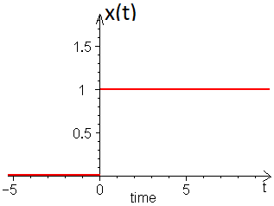

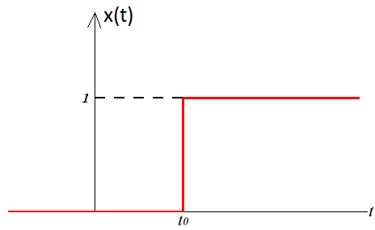
Unit Step Function:
The unit step function u(t) is defined as
Shifted unit step function u(t – t₀) is defined as
u(t) is discontinuous at t = 0, its value at t = 0 is undefined as different from u[n]
BLG354E - İTÜ Faculty of Computer Engineering and Informatics - Üstündağ

Slide 3
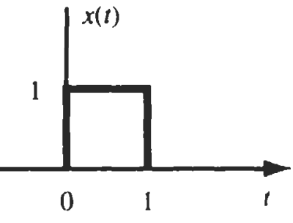
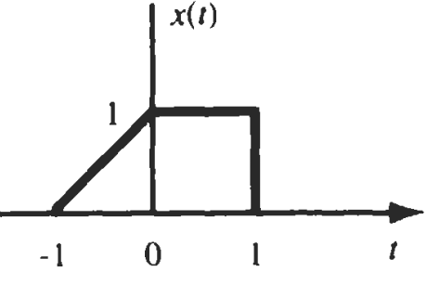
Example:
Express the signals shown in the figures in terms of unit step functions:
x(t)=u(t)-u(t-1)
x(t)=(t+1)[u(t+1)-u(t)]+[u(t)-u(t-1)]
x(t)=(t+1)u(t+1)-tu(t)-u(t)+u(t)-u(t-1)
x(t)=(t+1)u(t+1)-tu(t)-u(t-1)
x₁(t)=t+1
x
x₂(t)=u(t+1)-u(t)
BLG354E - İTÜ Faculty of Computer Engineering and Informatics - Üstündağ

Slide 4
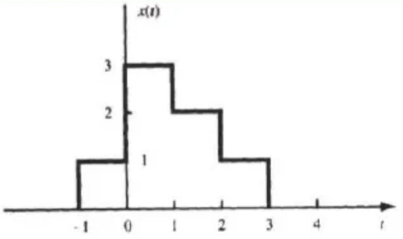
Example:
Express the signals shown in the figure in terms of unit step functions:
x(t)=(u(t+1)-u(t))+3(u(t)-u(t-1))+2(u(t-1)-u(t-2))+(u(t-2)-u(t-3))
x(t)=u(t+1)+2u(t)-u(t-1)-u(t-2)-u(t-3)
BLG354E - İTÜ Faculty of Computer Engineering and Informatics - Üstündağ

Slide 5




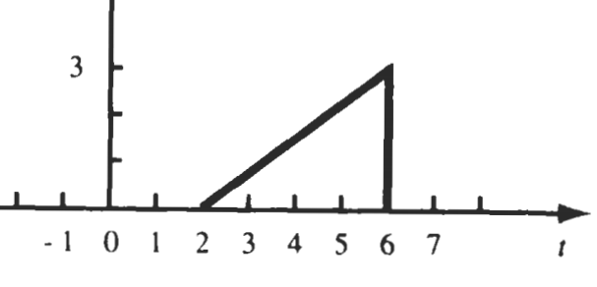
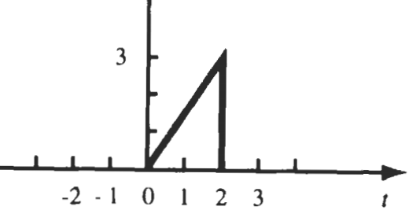
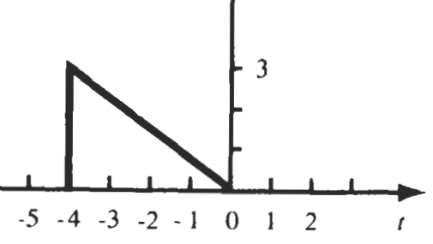
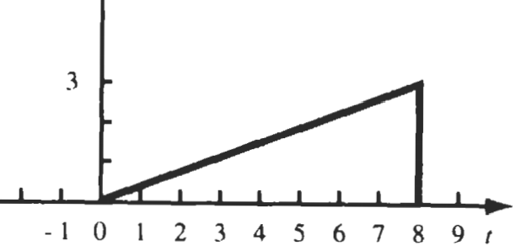
Example:
x(t) is a CT signal given in the graph
x(t)
a) Mathematically express the function
b) Find and sketch
c) Find and sketch
d) Find and sketch
e) Find and sketch
a) x(t)=0.75t[u(t)-u(t-4)]
b)
c)
d)
e)
BLG354E - İTÜ Faculty of Computer Engineering and Informatics - Üstündağ

Slide 6
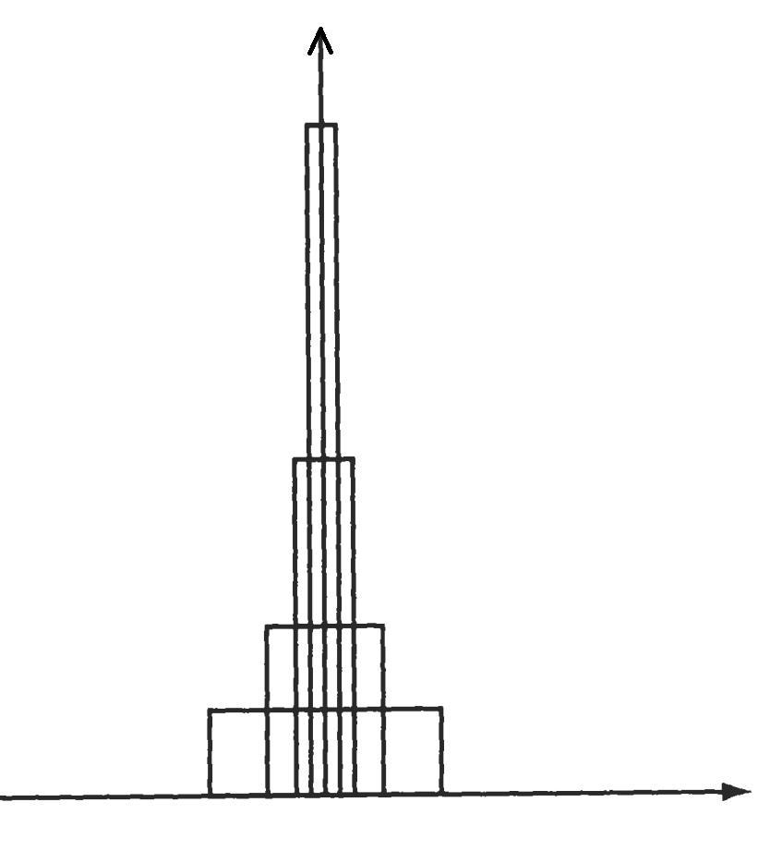
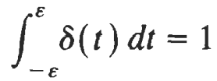

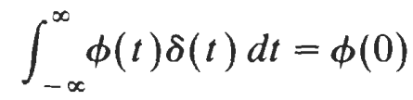
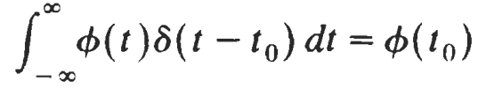
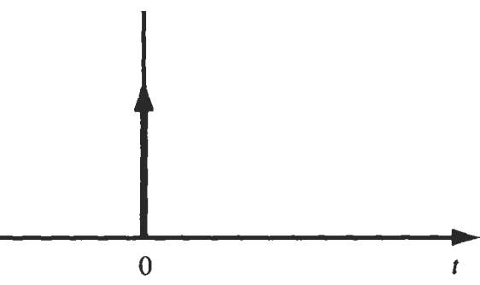
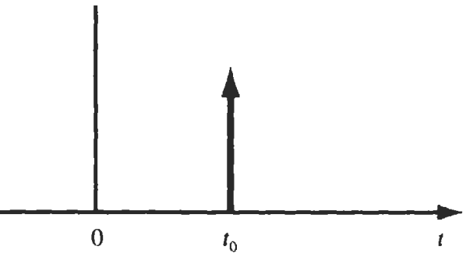
The Unit Impulse Function:
The unit impulse function δ(t), also known as the Dirac delta function, defined as the limit of a suitably chosen conventional function having unity area over an infinitesimal time interval.
δ(t)
Φ(t) is known as the testing function
δ(t) is called a generalized function
t₀ delayed delta function δ(t- t₀) is defined by
$$\frac{1}{ε}$$
ϵ→0
Φ(t) is any function continuous at t=t₀
δ(t)
δ(t-t₀)
Φ(t)
ʃ→
Φ(t₀)
t
ϵ
BLG354E - İTÜ Faculty of Computer Engineering and Informatics - Üstündağ

Slide 7
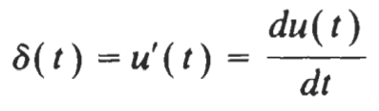
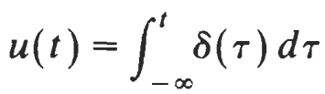

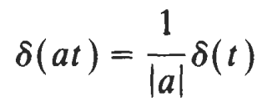

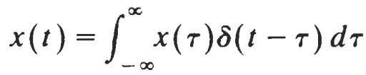

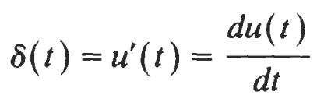

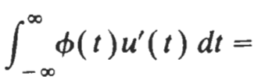

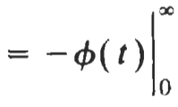


Properties of delta Dirac Function:
Proof:
Show that
→
BLG354E - İTÜ Faculty of Computer Engineering and Informatics - Üstündağ

Slide 8
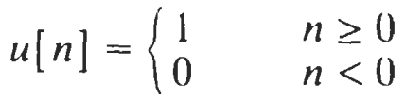
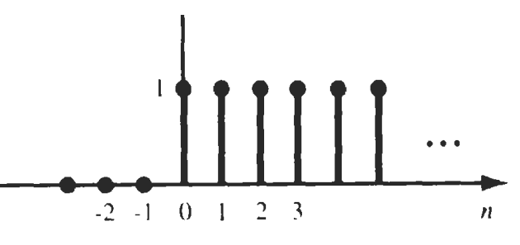
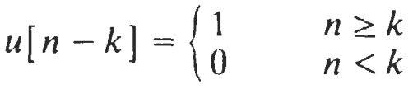
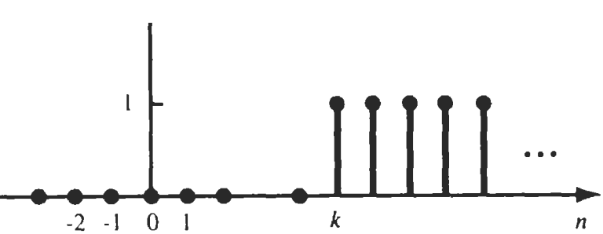
The Unit Step Sequence:
u[n]
Unlike the continuous-time step function u[n] at n=0, u[0]=1
u[n-k]
BLG354E - İTÜ Faculty of Computer Engineering and Informatics - Üstündağ

Slide 9
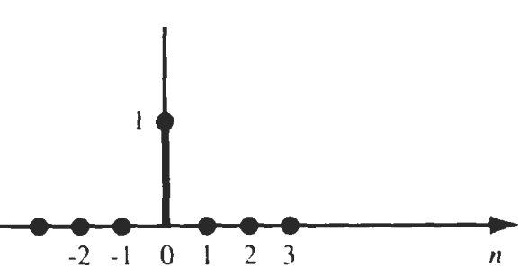
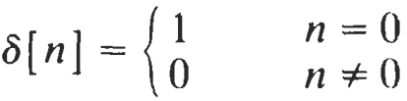

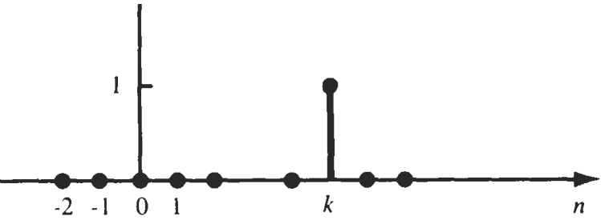

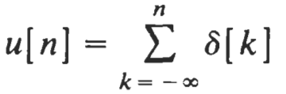
The Unit Impulse Sequence:
Unit impulse sequence δ[n] is defined as
δ[n]
δ[n-k]
BLG354E - İTÜ Faculty of Computer Engineering and Informatics - Üstündağ

Slide 10
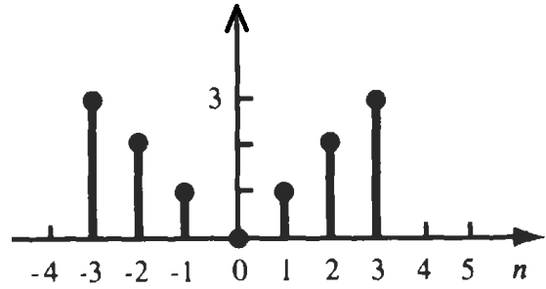


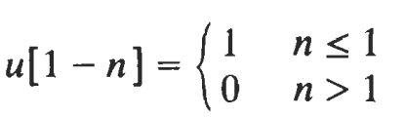
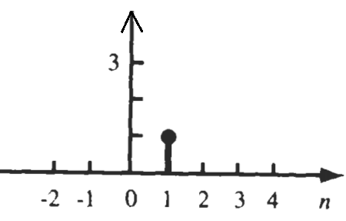
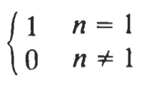



Example:
x[n]
a) Find and sketch
b) Find and sketch
x[n]u[1-n]
a)
x[n]δ[n-1]
b)
Example:
x[n] is given as x_{n}={-1,0,1,2,0,4} . Express x[n] as a function.
x[n]=-δ[n+1]+δ[n-1]+2δ[n-2]+4δ[n-4]
or
x[n]=n(u[n+1]-u[n-5])-3δ[n-3]
BLG354E - İTÜ Faculty of Computer Engineering and Informatics - Üstündağ

Slide 11


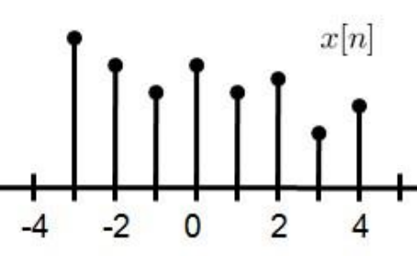
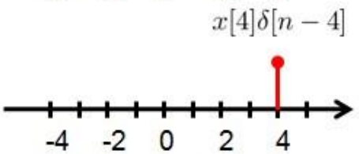
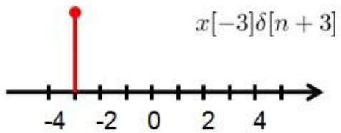
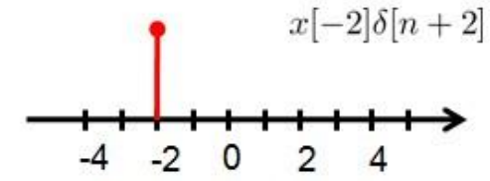
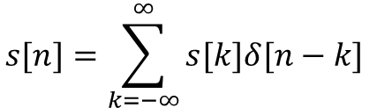
Vector Space:
Theorems of linear algebra provides that there is a basis {v_{k}}
→A set of signals in terms of which any signal s can be expanded
Here summation sigma indicates that there are finite or denumerable number of basis signals
If a nondenumerable infinity of basis signals is required then sum must be replaced by the integration:
Every vector space has a basis. In general, basis is not unique.
Any digital signal can be expanded by unit impulse functions as long as overlapping is avoided (orthogonality and linear independence):
$$s[n]=\sum_{k=−∞}^{∞}{s[k]δ[n−k] }$$
…+
=
+
n
BLG354E - İTÜ Faculty of Computer Engineering and Informatics - Üstündağ

Slide 12
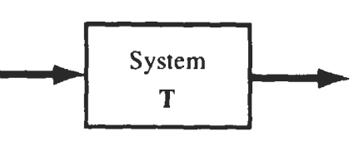
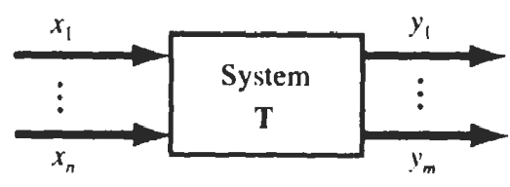
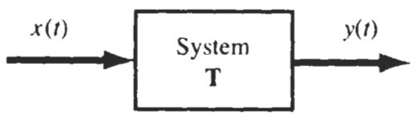

SYSTEMS and CLASSIFICATION of the SYSTEMS
The system is a transformation (or mapping) of x into y where x and y are the input and output signals, respectively. This transformation is stated as:
y=Tx
x
y
Single input-single output system
Multiple input-multiple output system
If the input and output signals x and p are continuous-time signals, then the system is called a continuous-time system
If the input and output signals are discrete-time signals or sequences, then the system is called a discrete-time system
BLG354E - İTÜ Faculty of Computer Engineering and Informatics - Üstündağ

Slide 13
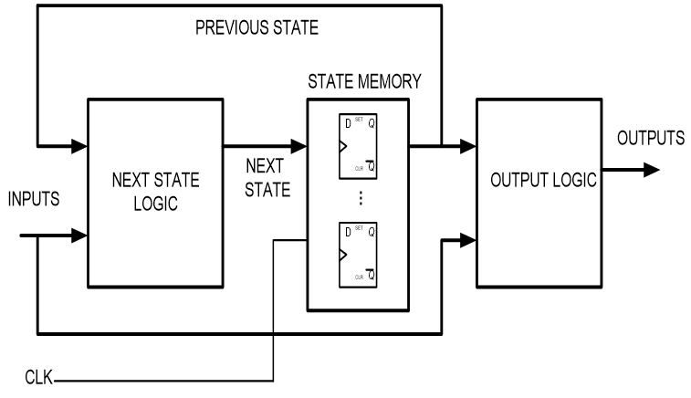
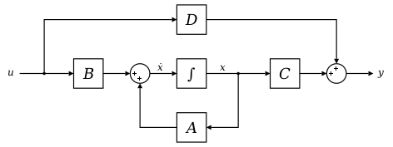
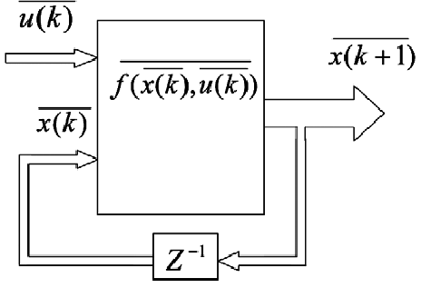
Systems with Memory and without Memory
A system is said to be memoryless if the output at any time depends on only the input at that same time. Otherwise, the system is said to have memory.
Is there a contradiction with the term “memoryless” due to definition of a system ?
State Space Model for
Continuous Time Systems
State Space Model for
Discrete Time Systems
Mealy Machine Model for Logical Systems
Output is not only a function of current input but also it depends on internal states, so the past input value(s)
BLG354E - İTÜ Faculty of Computer Engineering and Informatics - Üstündağ

Slide 14
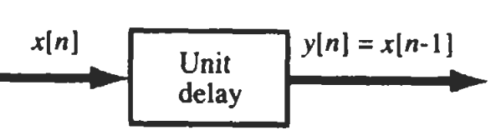
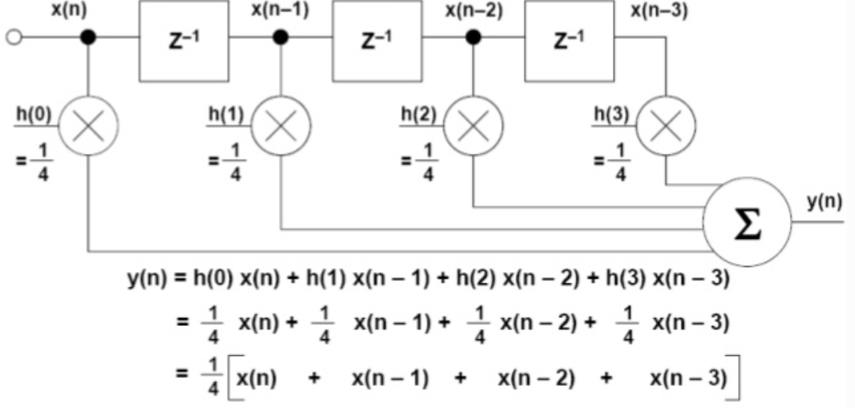


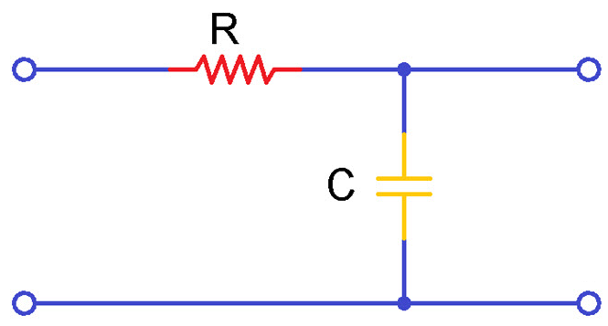
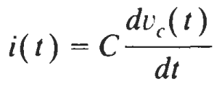
System examples having memory:
z⁻¹
=e^{-sT}
Moving Average Filter as a system with memory:
A
B
C
x[n] , A=x[n-1] , B=x[n-2] , C=x[n-3]
z⁻¹→ C=B , B=A , A=x[n]
Order of a system: Memory Units keeping the states
RC low-pass filter circuit as a system with memory:
Transfer
function
V_{in}
V_{out}
x(t)=V_{in}
y(t)=V_{c}=V_{out}
x(t)
Y(t)
T
Can you write a difference equation that simulates the RC filter Transfer function?
BLG354E - İTÜ Faculty of Computer Engineering and Informatics - Üstündağ

Slide 15




Linear and Non-Linear Systems:
A system is called linear if it satisfies additivity and scaling conditions
Additivity →
for any signals x₁ and x₂ , Tx₁ = y₁ and Tx₂ = y₂ then T{x₁ +x₂) =y₁+y₂
where T is the transfer function of the system
Scaling →
for any signals x and scalar α , T{αx₁}= αy₁
Superposition property for Linearity test:
A system is said to be linear if
T{α₁x₁+α₂x₂} = α₁y₁+α₂y₂
is valid for any signals x₁, x₂ and scalar α₁ and α₁
Example:
If transfer function of a system is given as y=T{x}=x² , show that this system is nonlinear.
T{x₁+x₂}≠ T{x₁} + T{x₂}
→ system is nonlinear
BLG354E - İTÜ Faculty of Computer Engineering and Informatics - Üstündağ

Slide 16
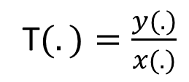






Causal and Noncausal Systems:
* If output of a system y(t) at an arbitrary time t = t₀ depends on only the input x(t) for t≤t₀ then it is called causal system.
Output of a causal system does not depend on its future values, it is only dependent on the present and/or past values of the input.
* A system is called noncausal if it is not causal.
For example, y(t)=x(t+1) is not a casual system
because it is not possible to obtain an output before an input is applied to the system.
Example:
$$T_{1}\left(z\right)=\frac{z^{2}−1}{z}$$
and
$$T_{2}\left(z\right)=\frac{z}{z^{2}−1}$$
Compare the casuality of DT systems having the transfer function
$$T_{1}\left(z\right)=\frac{y_{1}(z)}{x_{1}(z)}=\frac{z^{2}−1}{z}$$
=$z−z^{−1}$
→ y₁(k)=x₁(k+1)+x₁(k-1)
this system is not casual
Numerator
polynomial
T$(.)=\frac{y(.)}{x(.)}$
$$T_{2}\left(z\right)=\frac{y_{2}(z)}{x_{2}(z)}=\frac{z}{z^{2}−1}$$
$$=\frac{z^{−1}}{1−z^{−1}}$$
Denominator
polynomial
→ y₂(k)-y₂(k-1)=x₂(k-1)
this system is casual
System is casual if the order of numerator polynomial ≤ order of denominator polynomial
(the number of zeros must not exceed the number of poles)
BLG354E - İTÜ Faculty of Computer Engineering and Informatics - Üstündağ

Slide 17








Time-varying and Time-invariant Systems:
* A CT system is called time-invariant if any time shift τ in the input signal as x(t- τ) causes the same time shift in the output signal as y(t- τ):
* A DT system is called time-invariant if any integer amount of delay, k, in the input signal as x(n-k) causes the same amount of delay at the output signal as y(n-k):
* A DT or CT system which is not time-invariant is called a time-varying system
Proof:
Show that unit delay operator is time-invariant
z⁻¹
Let y₁[n] be the response to x₁[n] =x[n-n₀] then
→ system is time-invariant
BLG354E - İTÜ Faculty of Computer Engineering and Informatics - Üstündağ

Slide 18


Stable Systems:
There are many definitions of stability. BIBO stability:
A system is bounded-input/bounded-output (BIBO) stable if for any bounded input x defined by
|x|≤k₁
|y|≤k₂
where k₁ and k₂ are finite real constants
Stability definitions in control systems:
If a system is asymptotically stable, then it is also BIBO stable.
Peak time
Settling time

Slide 19









Example:
A basic amplitude modulator is shown in the figure below. Determine whether if this system is (a) linear, (b) memoryless, (c) causal, (d) time-invariant, or (e) stable
?
a) Lets apply the linearity test:
T{α₁x₁+α₂x₂} = α₁y₁+α₂y₂
y₁(t)
y₂(t)
=α₁y₁(t)+α₂y₂(t)
→ system is linear
b) The system is memoryless because the output value y(t)=x(t)cos ω_{c}t only depends on the active value of the input x(t)
c) It is a causal system since the output y(t) does not depend on the future values of the input x(t),
d) If we shift the input x(t) for t₀ as x₁(t)=x(t-t₀) then the output will be
The output y(t) at the time +t₀ is
Since y(t-t₀)≠y₁(t) the system is not time invariant
e) System is BIBO stable because
$$\left|y(t)\right|=\left|x\left(t\right)cos⁡(ω_{c}t)\right|≤\left|x(t)\right|$$
since
$cos⁡(ω_{c}t)≤$1
so if the input x(t) is bounded then the output y(t) is also bounded
BLG354E - İTÜ Faculty of Computer Engineering and Informatics - Üstündağ

Slide 20




Interconnectivity of the systems:
Cascaded Systems
Feedback Systems:
x(.)
y(.)
z(.)
y(.)
F=H·Y
E=X-F
Y=E·G
T₁(.)
T₂(.)
x(.)
+
E
G(.)
-
F
Y= (X-F)·G
$$T=\frac{Z}{Y}\frac{Y}{X}=\frac{Z}{X}=\left(T_{1}{∙T}_{2}\right)$$
H(.)
Y= (X-Y·H)·G
Y= X·G-Y·H·G
Parallel Systems
$$T=\frac{Y}{X}=\frac{G}{1+GH}$$
y₁(.)
T₁(.)
x(.)
z(.)
+
Negative Unit Feedback System:
y₂(.)
T₂(.)
y(.)
x(.)
+
E
G(.)
-
$$T=\frac{Y_{1}}{X}+\frac{Y_{2}}{X}=\frac{Z}{Y}=\left(T_{1}+T_{2}\right)$$
F
$$T=\frac{Y}{X}=\frac{G}{1+G}$$
BLG354E - İTÜ Faculty of Computer Engineering and Informatics - Üstündağ

